Slide 1
Introduction to computing
Week 1, Computational Genomics
Notes:
The goal of the lesson:
To develop programming vocabulary and grammar to code, and fundamentals to be independent later.
We will focus on key, but limited set of tools and you will try new things on your own.
Like learning a new language - not going through the dictionary, but a few common phrases for you to get around with...a computer.
Programming language is the common language between humans and computers.
Computers = powerful + stupid -- we need to speak the language, and also troubleshoot when it does something we don’t intend.
By the end of the week:
To look at some information about cancer cell lines, and write code to find out some background information, such as the number of cancer types, age of the samples, etc. Sets the stage to investigate complex genomics data next week.
Objective of this lesson: Students should be able to…
Explain why abstraction/representation in computation is useful/powerful/efficient.
Given a line of code, identify data types, expression, and functions.
Given a function, identify the function name, arguments, and possible return data type.
Break down a nested function to describe the iterative process that takes place in the nested function.
Describe what the computing environment is, and how variables are created, stored, and updated in it.
Predict what basic lines of R code will do.
Recognize data types that hold other data types (dataframes, vectors), and recall the commands to extract other data types from it.
Interpret boolean expressions and predict what they will return. Recognize that operations used for data types can be also used on R Objects (vectors, dataframes)

Slide 2
Learning how to code/compute is like learning a new language
There is...
Grammar structure
Vocabulary
Culture
A new way to think about a problem!
Requires lot’s of practice to be fluent!

Slide 3
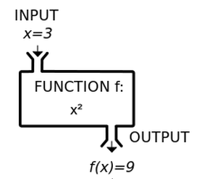
What is computing?
A powerful calculator that can perform expressions using operations or functions on data types that can be represented by variables.
Notes:
The function machine as a schema to understand an computational expression.
Think about high school algebra for functions and variables.
https://cs.wellesley.edu/~cs110/lectures/L16/

Slide 4
What is computing?
A powerful calculator that can perform expressions using operations or functions on data types that can be represented by variables.
> 18 + 21
> sum_of_ages = 18 + 21
> max(18, 21)

Slide 5
What is computing?
A powerful calculator that can perform expressions using operations or functions on data types that can be represented by variables.
Demo:
human age: operation with numeric data type
nucleotide sequences: string data type
seq = "ATCG"
nchar(seq)
Notes:
Examples beyond the calculator metaphor: Using numbers and strings to encode biology. There is no biology in our computers.
#2:
"ATCG"
seq = "ATCG"
Vector: can we use more complex structures to organize more complex biology?
#3:
c("ATCG", "AGCG")
seq = c("ATCG", "AGCG")
Maybe we can have a collection of gene isoforms of amino acids in a vector.
#Number of elements in the vector
seq[1]
seq[2]
#4:
length(names)

Slide 6
What is computing?
A powerful calculator that can perform expressions using operations or functions on data types that can be represented by variables.
Demo:
human age: operation with numeric data type
nucleotide sequence: string data type
gene expression of several samples : vector data object that contains other data types
geneZ_expression = c(8, 2, 3.5, 2.1)
geneQ_expression = c(0.2, .2, 1.2, 3)
length(geneZ_expression)
Notes:
Examples beyond the calculator metaphor: Using numbers and strings to encode biology. There is no biology in our computers.
#2:
"ATCG"
seq = "ATCG"
Vector: can we use more complex structures to organize more complex biology?
#3:
c("ATCG", "AGCG")
seq = c("ATCG", "AGCG")
Maybe we can have a collection of gene isoforms of amino acids in a vector.
#Number of elements in the vector
seq[1]
seq[2]
#4:
length(names)

Slide 7
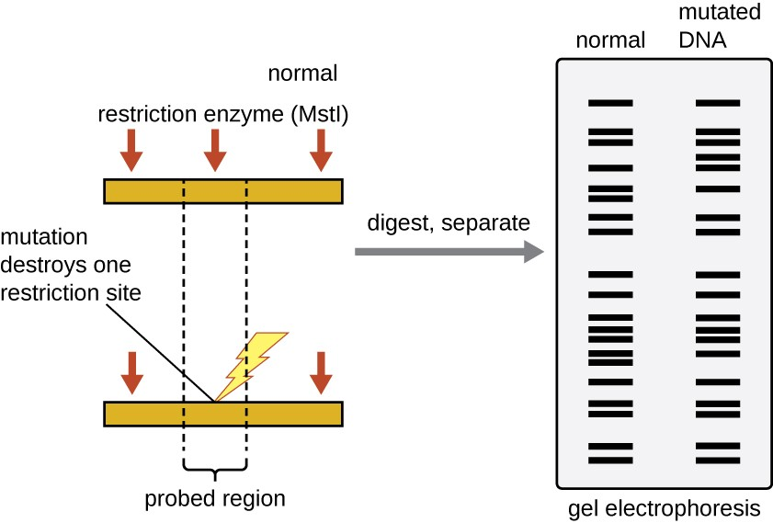
Theme: How do we encode and organize biology digitally?
sequence
MT_WT = c(“ATCG”, “ATGG”)
Notes:
https://courses.lumenlearning.com/microbiology/chapter/visualizing-and-characterizing-dna-rna-and-protein/

Slide 8
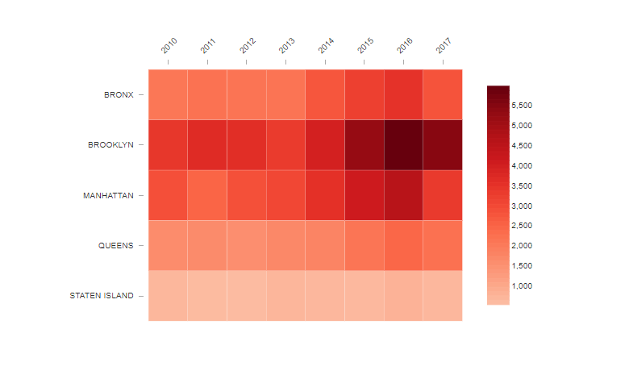
Theme: How do we encode and organize biology digitally?
gene gene
1 2
Sample 1
Sample 2
> GeneExpression =

Slide 9
Fundamentals of R programming grammar
Operations
- * / [ ]
Comparison operations
< <= >= & | ! ==
Functions
function(argument1, argument2)
Data types
Numeric
String
Logical
Data objects
Vector
Dataframe
In computation expressions, we apply operations and functions to data types and data objects.
Notes:
Operators and functions have appropriate inputs and outputs.

Slide 10
Fundamentals of R programming grammar
Operations
- * / [ ]
Comparison operations
< <= >= & | ! ==
Functions
function(argument1, argument2)
Data types
Numeric
String
Logical
Data objects
Vector
Dataframe
In computation expressions, we apply operations and functions to data types and data objects.
A function has a function name, arguments, and returns a data type.
Notes:
Operators and functions have appropriate inputs and outputs.

Slide 11
How does a computer read a function?
> sqrt(2 + 3 + 4)
> nchar(“hello”)
> c(2, nchar(“hello”), 4)
Execution rule for functions:
Evaluate the function by its arguments, and if the arguments are functions or contains operations, evaluate those functions or operations first. The output of functions is called the “returned value”.
Notes:
If we can understand how a function is read, most of the other parts of understanding an expression falls into place.

Slide 12
How does a computer read a function?
> sqrt(nchar(“hello”))
> c(2, nchar(“hello”), sqrt(nchar(“hello world”)))
> (nchar(“hello”) + 4) * 2
Notes:
Nested functions: think FoG(x) from algebra.
Parentheses are not technically functions, but they give the order of what operations should take place first.

Slide 13
Variable assignment and environments
Execution rule for variable assignment:
Evaluate the expression to the right of =.
Bind variable to the left of = to the resulting value
The variable is stored in the environment.
<- is okay too!
The environment is where all the variables are stored, and can be used for an expression anytime. Only one unique variable name can be defined.
Notes:
Datacamp does <-

Slide 14
Variable assignment and environments
Execution rule for variable assignment:
Evaluate the expression to the right of =.
Bind variable to the left of = to the resulting value
The variable is stored in the environment.
<- is okay too!
The environment is where all the variables are stored, and can be used for an expression anytime. Only one unique variable name can be defined.
> nChrs = 23
> myVector = c(2, 3, 4)
> completed = FALSE
Notes:
Datacamp does <-

Slide 15
Console Environment
> nChrs = 23
nChrs = 23
Notes:
Do this in RStudio
Mutable vs. not mutable - modifying nChrs does not change the value of totalChrs.
# as comment

Slide 16
Console Environment
> nChrs = 23
> nAutosomes = nChrs - 1
nChrs = 23
nAutosomes = 22
Notes:
Mutable vs. not mutable - modifying nChrs does not change the value of totalChrs.
# as comment

Slide 17
Console Environment
> nChrs = 23
> nAutosomes = nChrs - 1
> totalChrs = nChrs * 2
nChrs = 23
nAutosomes = 22
totalChrs = 46
Notes:
Mutable vs. not mutable - modifying nChrs does not change the value of totalChrs.
# as comment

Slide 18
Console Environment
> nChrs = 23
> nAutosomes = nChrs - 1
> totalChrs = nChrs * 2
> nChrs = 8 #fly genome
nChrs = 8
nAutosomes = 22
totalChrs = 46
Notes:
Mutable vs. not mutable - modifying nChrs does not change the value of totalChrs.
# as comment

Slide 19
Rstudio Demo
Console
Environment
Source document
Problem set 1: Rmarkdown
Notes:
Break?
Takes 45 min?

Slide 20
Fundamentals of R programming grammar
Operations
- * / [ ]
Comparison operations
< <= >= & | ! ==
Functions
function(argument1, argument2)
Data types
Numeric
String
Logical
Data objects
Vector
Dataframe
Data objects have properties that can be accessed by functions, and have [], $ operations for subsetting.
Notes:
Operators and functions have appropriate inputs and outputs.

Slide 21



Vector
A ordered collection of data types.
Numeric
String
Logical

Slide 22
Vector
The combine function creates a vector.
numbers = c(1, 50, 9, 42)
strings = c(“A”, “B”, “C”, “D”)
logical = c(TRUE, FALSE, FALSE, TRUE)
Properties
> length(numbers)

Slide 23
Vector
We can subset a vector using [ ] operations,
by using numerics, indexing vector, or logical indexing vector.
> numbers[1] #numerics
> numbers[c(2, 4)] #indexing vector
> numbers[c(FALSE, TRUE, FALSE, TRUE)] #logical indexing vector
Notes:
The bracket [ ] is an operation to pull out elements from a vector.
Similar to a function, if there are any additional operations or functions within the [ ], expression those expressions first before evaluating the [ ].
Index vectors are tricky because there’s 3 vectors going on at once.
In the Datacamp exercises, you will learn how to do arithmetic on vectors. Ie vec1 + vec2, etc. You will also learn 1:5 way of creating vectors. You will also learn about names for vectors, and selection using the vector element name.

Slide 24
Dataframe
Each column is a vector, and they can hold different kinds of data.
Like Excel spreadsheets.
1 | “A” | TRUE
50 | “B” | FALSE
9 | “C” | FALSE
42 | “D” | TRUE
Notes:
You can store a dataframe in just one variable.

Slide 25
Dataframe
Dataframes are often created using existing sources.
> gene_expr = read.delim(‘gene_expression.csv’, sep = ”,”, stringsAsFactors = F)
> dataframe = data.frame(numbers, strings, logical)

Slide 26
Dataframe
Dataframes are often created using existing sources.
> gene_expr = read.delim(‘gene_expression.csv’, sep = ”,”, stringsAsFactors = F)
> dataframe = data.frame(numbers, strings, booleans)
Properties
> nrow(dataframe)
> ncol(dataframe)
> dim(dataframe)
> colnames(dataframe)

Slide 27
Dataframe
We can subset a dataframe using [ ] and $.
Numerically
dataframe[row, col]
> dataframe[2, 3]
> dataframe[ , 3]
> dataframe[2, ]
With indexing vectors
> dataframe[c(2, 3), c(2, 3)]
> dataframe[c(1, 3), c(2, 3)]
1 | “A” | TRUE
50 | “B” | FALSE
9 | “C” | FALSE
42 | “D” | TRUE
Notes:
Where in the table is this accessing?

Slide 28
Dataframe
We can subset a dataframe using [ ] and $.
> colnames(dataframe)
> dataframe$logical
> dataframe$logical[c(1, 2)]
> dataframe[c(1, 2), c(“logical”)]
> dataframe[c(1, 2), c(“numbers”,
“logical”)]
“numbers” “strings” “logical”
1 | “A” | TRUE
50 | “B” | FALSE
9 | “C” | FALSE
42 | “D” | TRUE
Notes:
Where in the table is this accessing?

Slide 29
Explicit vs. implicit subsetting
Explicit
Suppose someone approaches you a 1000-length vector of people’s ages, and say that they want to subset to the first 100 elements.
Implicit
Suppose someone approaches you a 1000-length vector of people’s ages, and say that they want to subset to elements < 18 age.
...

Slide 30
Comparison operations and logical data types
Operators that compare data types: >, =>, <, <=, ==, !=
> 4 > 2
> 4 < 2
> 4 == 2
> “Gene1” == “Gene2”
> “Gene1” != “Gene2”
Notes:
This is useful for subsetting in vectors and dataframes.

Slide 31
Comparison operations and logical data types
Operators that compare data types: >, =>, <, <=, ==, !=
Operators that extend comparisons: &, |
> 4 > 2 & “Gene1” != “Gene2”
> 4 > 2 | 4 < 2

Slide 32
Comparison operations and logical data types
Operators that compare data types: >, =>, <, <=, ==, !=
Operators that extend comparisons: &, |
For vectors:
> age = c(45, 23, 80, 3)
> age > 30
> TRUE, FALSE, TRUE, FALSE
Notes:
Comparison operators can be used for vectors.
It returns a vector of the same length, and each element is a T/F value corresponding to the comparison operation as if it is performed element-by-element.

Slide 33
Comparison operators for subsetting vectors
> vector = c(2, 3, 4)
> indexing_vector = vector > 2
> vector[indexing_vector]
> vector[vector > 2]
> vector[vector > 2 & vector < 4]
Notes:
Datacamp will show you a different way using the subset() function

Slide 34
Comparison operators for subsetting dataframes
> dataframe$numbers[dataframe$numbers > 3]
> dataframe[dataframe$numbers > 3, c(“numbers”) ]
“numbers” “strings” “logical”
1 | “A” | TRUE
50 | “B” | FALSE
9 | “C” | FALSE
42 | “D” | TRUE
Notes:
Datacamp will show you a different way using the subset() function

Slide 35
Fundamentals of R programming grammar
Operations
- * / [ ]
Comparison operations
< <= >= & | ! ==
Functions
function(argument1, argument2)
Data types
Numeric
String
Logical
Data objects
Vector
Dataframe
Properties
Subsetting
Explicit
Implicit
Notes:
Operators and functions have appropriate inputs and outputs.

Slide 36
Summary
A powerful calculator that can perform expressions using operations or functions on data types that can be represented by variables.
What are the strategies of encoding and organizing biological information digitally?

Slide 37
Additional resources
Datacamp: Introduction to R. Sections 1, 2, 5: Intro, Vectors, Dataframes: https://learn.datacamp.com/courses/free-introduction-to-r
R Programming for Data Science. Chapters 4 and 9. https://bookdown.org/rdpeng/rprogdatascience/

